Slide 1
Wandsworth Schools Primary PE Forum
Stamford Bridge Football Ground
19th June 2017

Slide 2
Welcome to Stamford Bridge

Slide 3
Outline of the day
9:30pm – Welcome & Introductions
9.45am Mike Weeks – GymRun
10.05am School Games Update
10.20am – School Games Mark 2017
11am - Break- Tea & Coffee
11.15am – Daily Mile – Natalie Pope
11.40am – Allstar Tennis – Emma Wells
12.00 noon – CPD 2018
Wandsworth District Football – Richard Siaw
Freddie Ocrah
12.30pm - Lunch
1.15pm – Premier League Primary Stars
1.30pm - CFC SEN - Removing the Fear Workshop
2.30pm - Depart

Slide 4
Mike Weeks GYMRUN
Rethinking Fitness in Primary Schools –
The Fitness Rainbow
A simple measurement tool

Slide 5
London School Games Finals 2017
Spring Finals 2016
Qualifiers for Summer Finals 2017
3rd Northwood - Tag Rugby
5th Ravenstone - Sportshall Athletic
14th Honeywell - Girls Football
21st Honeywell - Quicksticks Hockey
22nd The Roche - Hi 5 Netball
29th St Michael’s - Boys Football
RFU Mega Fest – Holy Ghost
Belleville – Y5/6 Gymnastics
Belleville – Y3/4 Gymnastics
Newton Prep – Best Cricket
Furzedown -LYG
Thomas’s Clapham – Girls Cricket
Belleville -LYG
Penwortham - Basketball
Belleville – Year 3/4 Mini Tennis

Slide 6
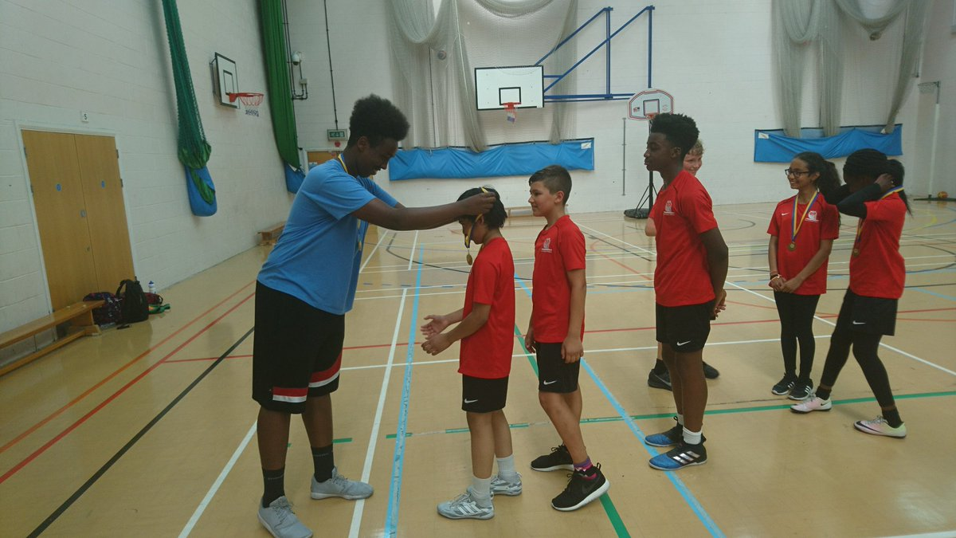
School Games Photo Call

Slide 7
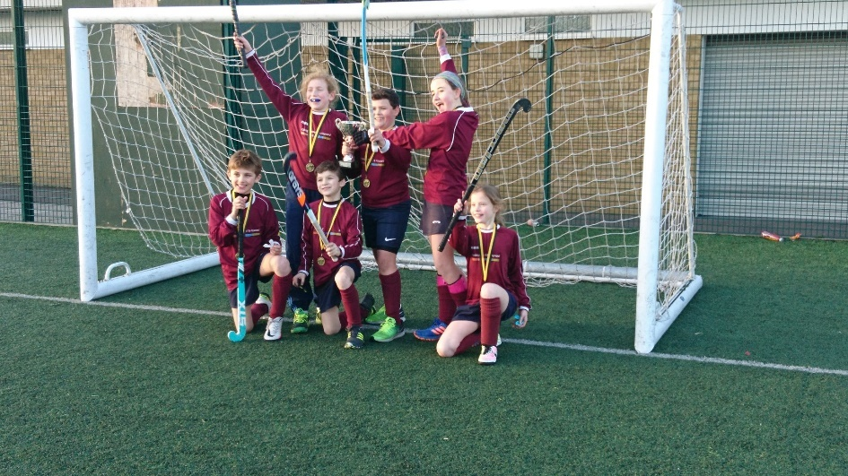
Wandsworth School Games Events
22nd June Y5/6 Mini Tennis Orange – KGP
23rd June – Y5 Girls Football -SA
26th June – Y5 Cricket – Spencer
28th June – Tri Golf – CLGC
29th June Volleyball - EBC
30th June – Quad Kids – SA
3rd July – Primary Panathlon -SA

Slide 8
National
School Games Update
Targets for 2018

Slide 9
Mission
Keeping competitive sport at the heart of schools and provide more young people with the opportunity to compete and achieve their personal best.
Vision
By 2020 the School Games will be continuing to make a clear and meaningful difference to the lives of even more children and young people.
Notes:
Important at the start of the updates to re-iterate the Mission and Vision for the School Games of the back of the review.
Emphasise more Young People (Personal Best) not more events for same Young People
Meaningful difference – greater than participation (what difference is the calendar making, how many different Young People experience this difference....are they the young people that need it most?).

Slide 10
SG KPI - Participation
% of schools actively engaged in School Games
= Registered on SG Website and enter minimum two inter-school events (L2)
*sliding scale of total number of Schools in SGO Area
00 - 19 schools - 90%
20 - 39 schools - 79%
40 - 59 schools - 75%
60 - 79 schools - 70%
80 - 99 schools - 63%
100 - 120 schools - 60% -
Question – Percentage of Wandsworth Schools?
Notes:
Important to note this KPI will be measured through SG Website.

Slide 11
SG KPI - Participation
% of schools applying for School Games Mark
Sliding scale of total number of Schools in SGO Area
00 - 19 schools - 70%
20 - 39 schools - 50%
40 - 59 schools - 45%
60 - 79 schools - 42%
80 - 99 schools - 37%
100 - 120 schools - 35% -
Question No. of Wandsworth Schools applying in 2016?
Notes:
Applying not achieving

Slide 12
SG KPI Targets for 2017– Competition
Competition Calendars uploaded – 31st July 2017
22 Events – Level 2 Competitions –
10 Sports providing a pathway/progression into County Final (Level 3) title Pathway Events
2 Development Events (Level 2)
2 Festivals (Level 2)
Quiz questions?
Notes:
The implications of these KPI’s pose the biggest risk to the School Games. Having recently celebrated 1million participants – there is currently a strong connection to the Games. From the consultation resounding feedback 10 Sports was too small. On 3 days/week this number still allows a positive amount of time to undertake the other areas of the role – BUT if everyone only does the minimum there will be a large decrease in numbers, and could provide a risk to the investment.
a. ‘Pathway Competitions’ - an inter school competition where the winners feed into the county final (Level 3). These competitions must adhere to the NGB Priority formats. Further
b. ‘Development Competitions’ - an inter school competition where there is no pathway to the county final. The purpose of these events can be established locally. The key philosophy with development competitions is there is a clear and mutually agreed reason for the sport/activities inclusion in an SGO Calendar of Competition and is supporting the engagement of different Young People e.g. B/C Teams, new sport
c. Festival (Yr.3/4) - an inter school festival which includes a rotation of skill based activities which challenge young people to achieve their personal best e.g. jumping, throwing, catching, skipping, racket skills, combat, adventure, target themed. Support and guidance will be developed to deliver Multi Skill festivals, including activities involved and potential event formats.

Slide 13
SG KPI - Clubs
Every SGO to have 80% of target clubs sustained for a
minimum of 12 weeks in clubs with a Change 4 Life
ethos and principles.
Each SGO identify and engage a minimum of
8 community exit routes (Sports Club, leisure provider, youth club, outdoor activity provider)

Slide 14
Workforce
Minimum of 45 young people supported and
receiving ongoing training through a Leadership Academy
Ernest Bevin – Cricket - Leaders Course
Southfields / Burntwood – GameForce Organisers Award
Graveney – Tennis Leaders Course
Southfields – Basketball Officials Course
Minimum 60% of Level 2 workforce is made up of young people (U18) . In addition to the above:
Putney High – KS Gymnastics
Ernest Bevin/Burntwood – Sportshall Athletics
Notes:
Question on what could be included in a Leadership academy and what constitutes a Leadership Academy.
Support with tracking required
What is ongoing, needs more clarity
Funding required
Concerns of the ability to work intensively with 45 young people in a Leadership Academy

Slide 15
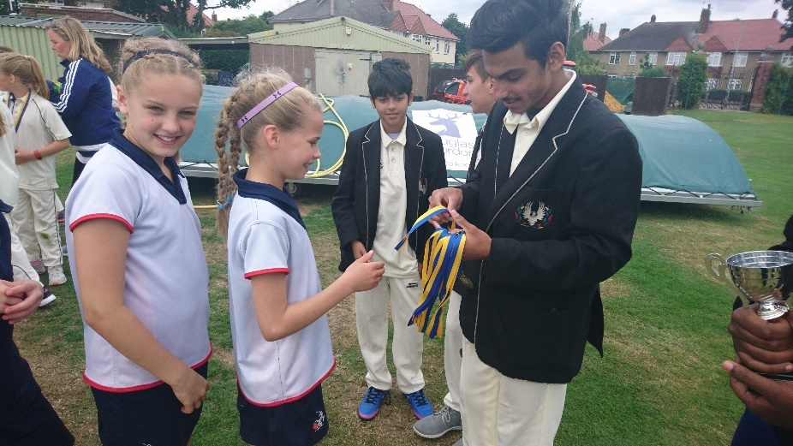
School Games Workforce

Slide 16
School Games Mark 2017
Application window – Open until – 31st July 2017
Part of School Games programme
Recognised by Ofsted
Promotes sporting success
Links with Sports Premium fund
Recognition of schools hard work & commitment to PE & Sport
40 Wandsworth School successfully gained Award in 2016
4 Gold Awards, 21 Silver, 15 Bronze

Slide 17
Pre-requisites School Games Mark
During the academic year 2016/17 schools must have:
Register a School Games day on www.yourschoolgames.com
A calendar of competition that demonstrates opportunities for young people with SEND
A notice board and/or in-house school digital system that promotes School Games activity.
System tracking young people’s participation in School Games.
Opportunities that attract less active young people to participate in physical Activity.
Completed the Inclusive Health Check tool.

Slide 18
Bronze award
Plans to provide 2 hrs of PE & sport a week
20% of students engaged in extracurricular activity every week.
Use School games formats to provide 5 x Level 1 competition opportunities – Intra school
Compete in 3 Level 2 competitions – Inter School
Engage 5% of students in leading, managing & officiating activity

Slide 19
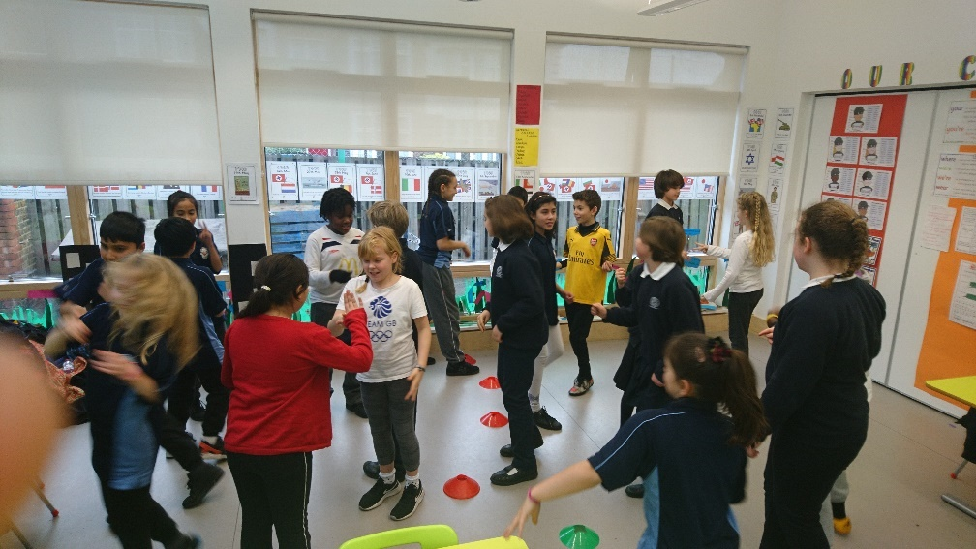
Silver Award
Provide 2 hrs of PE & school sport per week
6 x Intra School Competitions – Level 1
4 x Inter school competitions – Level 2
Promote to parents via newsletter/website/social media
10% students leading & officiating
Students plan & development School Games
Utilise specialist coaches
Active links with 3 sports clubs

Slide 20
Gold Award
Provide 2 hrs PE & sport in curriculum per week
8 x Intra School Competitions – Level 1
6 x Inter school competitions – Level 2
Promote to parents via newsletter/website/social media every 2 weeks
15% students leading & officiating
School Games Crew in place
Utilise specialist coaches
Active links with 5 sports clubs
Train school staff to support school sport
Provide support for gifted & talented
All pupils provided opportunity to take on leadership roles in PE Lessons

Slide 21
ACE TIPS FOR SGM 2017
Read criteria carefully!
School Games Mark Criteria 2017 available on webpage
Supporting information for school
Collate evidence in a folder
Set up a Twitter account to promote all activities
Come along to SGM workshops/clinics at Southfields, 3.30-5.30pm
Wednesday 5th July
Monday 17th July
Tuesday 18th July
Keep in touch up until 31st July
Follow on Twitter @wandschoolgames

Slide 22
Daily Mile in Primary Schools Natalie Pope – Enable Leisure

Slide 23
Richard Siaw Wandsworth District Football

Slide 24
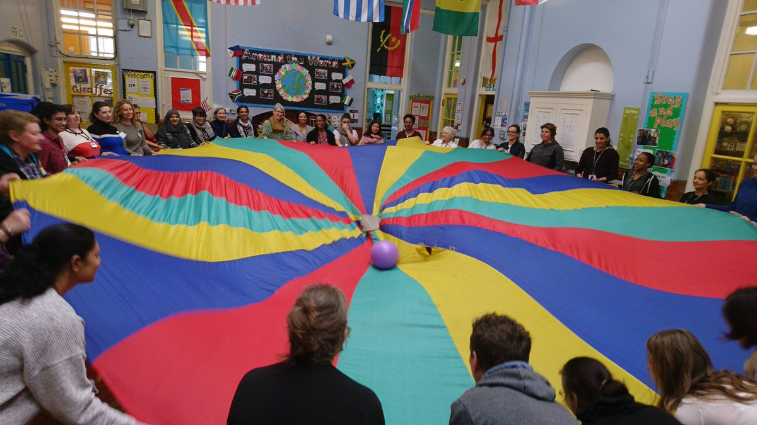
Wandsworth CPD programme
3 x Primary PE Forums
Programme of Sports Specific Courses:
Netball workshop
Quick Sticks
FA Primary Teachers Award
RFU Rugby Ready
Primary Cricket with Surrey Cricket
Primary Tennis with LTA
Primary Volleyball
Dance Inset
Playground Leaders Courses;
Southmead, St Georges, Sherindale. OLQH, Penwortham, Fircroft. Ronald Ross
Lunchtime Supervisors Courses for 5 schools

Slide 25
What CPD would you like in 2018?
Athletics
Sportshall Athletics Course
Free teaching resources available:
www.schools.london2017athletics.com/
Join celebration of athletics: www.TeamPersonalBest.org

Slide 26
Thanks For coming

