Slide 1
Active Wandsworth Primary PE Forum –September 2016
Southfields Academy
23rd September 2016

Slide 2
Welcome

Slide 3
Agenda
9.30am – Arrival
9.40am – Overview of the day
9.45am – Putney Leisure Centre – Diving Programme – Melinda Matyas
10am – School Games Mark & School Games Review - Nick
10.15am – PE Premium & Obesity Strategy -Peter
10.30am – Competition & CPD offer for 2016/17
10.45am – Henning Schmidt – Hillcroft Lacrosse
11am – Break
11.15am – Beat It! Children’s Weight Management Programme (Anne-Marie)
11.30am – School Running Initiatives (Peter)
11.40am-11.50pm – Lifetime Tennis
11.50-12 Noon – AFC Wimbledon Foundation
12:00-12:.30pm – Wandsworth Netball Club

Slide 4
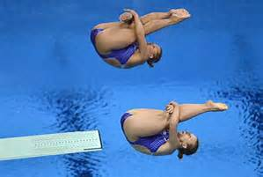
Melinda Matyas – Putney Leisure Centre – Diving Programme

Slide 5
School Games Mark 2016
Application deadline 28th Sept
21 schools successful so far:
Gold –Broadwater, Penwortham
Silver: OLV, TSM, Franciscan, Sacred Heart Roehampton, St Boniface, OLQH, Swaffield, Griffin, Brandlehow.
Bronze: St George’s, Wix, Riversdale (P), Southmead, Hotham, Sheringdale, Falconbrook.

Slide 6
Last train to School Games Mark http://www.yourschoolgames.com
What?
School Games Mark – Award for schools engagement in School Games.
How?
Easy to compete on line
School Games Mark Criteria 2016
available on webpage
Contact Nick for login details
Why?
Part of School Games programme
Recognised by Ofsted
Promotes sporting success
Links with Sports Premium fund
Recognition of schools hard work & commitment to PE & Sport

Slide 7
School Games Review 2016 - Recommendations
Recommendations were made to improve the following areas:
Update the vision and ethos of the Games – by refreshing the sporting formats
Engaging more children by promoting enjoyment regardless of ability
Creating better links with community sport
Volunteering opportunities across all levels of the School Games
Accountability of the School Games Organisers.

Slide 8
School Games Level One to Three
Focus should be on:
those not currently participating
better use of digital technology and social media
personal best challenges

Slide 9
Wandsworth School Games 2017
Primary Panathlon – 16th Nov & 3rd July
Boys /Girls Football
Sportshall Athletics
Tag rugby - NEW RULES
Water Polo
Hi 5 Netball
Quicksticks Hockey
KS Gymnastics
Quadkids Athletics
Boys & Girls Cricket – NEW FORMAT
Tri Golf
Mini Tennis – Red & Orange
3v3 Basketball
www.wandschoolgames.co.uk

Slide 10
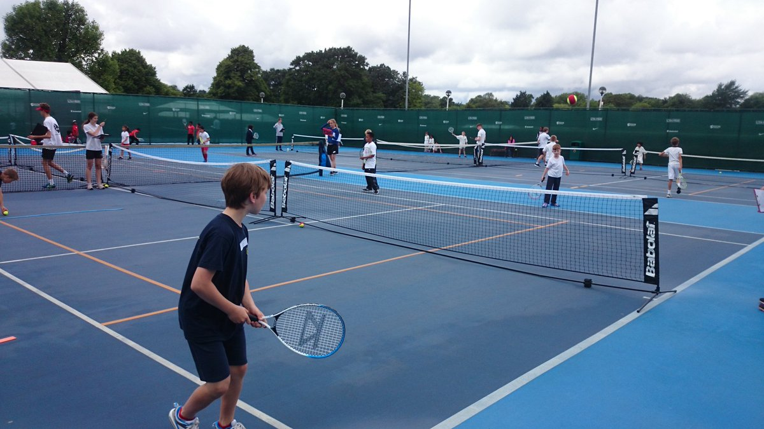
Additional Competitions 2017
AFC Wimbledon Kids Cup – 22nd Nov
CFC Premier League Competition – 11th Jan
Y3/4 Sportshall Athletics -14th & 16th March
Wandsworth District Year 5 Football -May
AFC Wimbledon Year 4 football
RFU Mega Fest – Year 4
Mini Volleyball Festivals

Slide 11
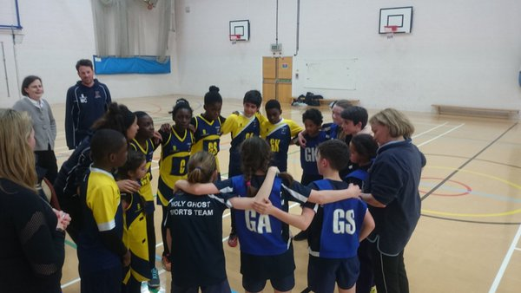
Spirit of the Games – Personal best
Rewarding schools for displaying Spirit of the Games values received really positive feedback from schools, teachers & children.
Respect
Teamwork
Pasion
Determination
Self Belief
Honesty
The aim of School Games is to encourage children to provide enjoyable & positive experience.
School Games code of Conduct to be adhered to for every event.

Slide 12
Better use of digital technology and social media
New look webpage:
www.wandsworthschoolgames.com
Login: your email address
Password: 123456
Please note that competitions run by
Enable have a different booking system
Please follow us on Twitter :
@wandschoolgames
@activewands
Does your school have a twitter account?
If so let us know!
www.yourschoolgames.com
School Games Mark
Inclusive Health Check
Blog your successes
Prizes to be one
Great resources for teachers
Sports Format & cards

Slide 13
PE & Sport Premium Update
Confirmed for this academic year 2016-17, same as previous years.
Grant of £8,000 per year plus £5 per pupil
Payment Schedule – 2 instalments made by Local Authority
First payment 29th October 2016
Second payment 27th April 2017
Academies, Free & Independent schools have different payment dates
For more info go to:
https://www.gov.uk/guidance/pe-and-sport-premium-for-primary-schools

Slide 14
Primary PE Funding 2016/17
Purpose of grant is to make additional & sustainable improvements to provision of PE & Sport benefitting all pupils
Government does not consider the funding to be spent on employing coaches or specialist teachers to cover PPA. These should come out of core staffing budgets.
Schools must publish information of the premium on their website by 4 April 2017 and include:
The amount of funding received
A full breakdown of how /or will be spent
What impact the school has seen on pupils PE & sport participation and attainment and demonstrate how the improvements will be sustainable in the future.

Slide 15
New Sport England priorities:
Doubling the Primary PE and Sport Premium and continue to fund School Games
More sport and activity before and after school
Focus on supporting inactive children and students at transitions between both primary and secondary
Funding for projects where families with children can get active and play together
Increase in the percentage of children achieving swimming proficiency and Bikeability

Slide 16
Childhood Obesity A Plan for Action
1. New soft drinks levy
To be invested in programmes to reduce obesity and encourage physical activity and balanced diets for school age children from 2017.
This includes:
• Doubling the Primary PE and Sport Premium
• Further funding for healthy breakfast clubs

Slide 17
Childhood Obesity A Plan for Action
2. Helping all children to enjoy an hour of physical
activity every day
Every primary school child should get at least 60 minutes of moderate to vigorous physical activity a day.
At least 30 minutes should be delivered in school every day through active break times, PE, extra-curricular clubs, active lessons, or other sport and physical activity events
The remaining 30 minutes supported by parents and carers outside of school time.

Slide 18
Childhood Obesity A Plan for Action
3. Schools will be supported on how they spend their available funds for maximum impact.
Ofsted assess effective use the Primary PE and Sport Premium
Physical activity will be a key part of the new healthy schools rating scheme
Schools will continue to have the freedom to consider spending the Primary PE and Sport Premium but PHE will be developing advice to schools for the academic year 2017/18.
PHE will make available a new interactive online tool which will help schools plan at least 30 minutes of physical activity every day.

Slide 19
Childhood Obesity A Plan for Action
5. A new healthy rating scheme for primary schools
A new voluntary healthy rating scheme for primary schools, building on existing schemes
Schools should celebrate healthy approaches towards tackling obesity amongst their pupils,
Annual competition to recognise schools with the most innovative and impactful projects will be launched
Ofsted will be refer to this scheme in the school inspection handbook

Slide 20
Primary School Contribution to School Games Consultation
Administration Support
CPD
Facility Hire
Medals
Certificates
Printing costs
Officials / Referees
Wandsworth LYG T-Shirts
Surrey Schools Cricket Affiliation
3 x Primary PE Forums
Programme of Sports Specific Courses
Inclusive PE Courses/Advice/Competitions/IHC
School Games Mark Advice
Bespoke training courses for teachers & support staff
C4L Training Days
Playground Leaders courses
Lunchtime Supervisors Courses

Slide 21
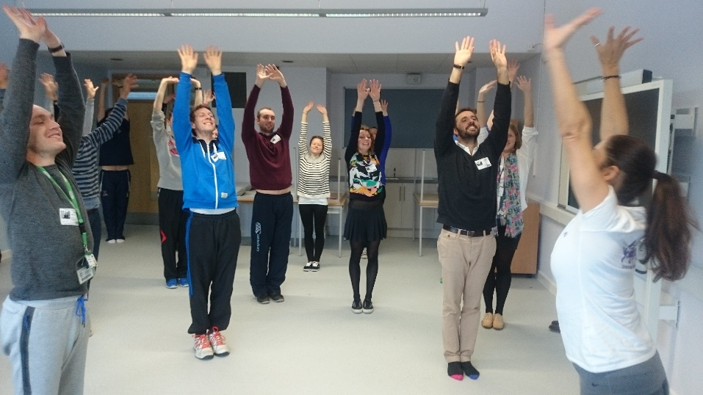
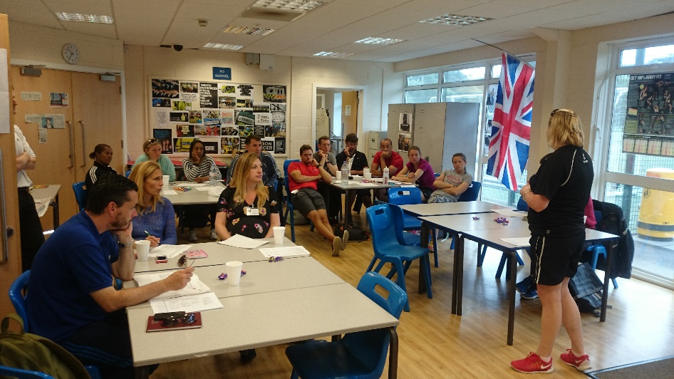
CPD Courses for teachers
Primary Netball-Today
Quicksticks Hockey – 2nd Nov
FA Teachers Course – 4th Nov
Primary PE Forum 5th Jan TBC
Inclusive PE
Tag Rugby -6th Feb TBC
Primary Tennis
Cricket
Volleyball
PE Forum 3

Slide 22
C4L ‘Inspired’ Clubs
A C4L Inspired Club 
Extra curricular Clubs with C4L aims & ethos:
Targets least active & increases physical activity
Promotes & improves healthy & active lifestyles
Embedded in school improvement
Creates a sense of belonging
Exciting & inspirational environment
Uses some C4L Resources / cards / equipment
Runs for 12 weeks
Plan to run a number of C4L Inspired training days at host schools. 4-5 schools would send along potential C4L Club Delivers & Champions
LONDON NETWORK DAY – 10th May 2016
Notes:
Are any of your schools running health related OSHL clubs that utilise C4L Ethos/aims, but are not necessary called C4L clubs?
Are their any lunchtime programmes that target less active young people, such as LTS clubs?

Slide 23
Change for Life Training Days
Primary Club Deliverer
Role: Establish & deliver club and recruiting least active participants
Can be:
Teacher
Teaching Assistant
Lunchtime supervisor
Parent
Young Ambassador
Change4Life Champions
Year 5/6 students
Promotion and delivery of the club
Healthy active lifestyles ambassadors across school
Peer to peer support

Slide 24
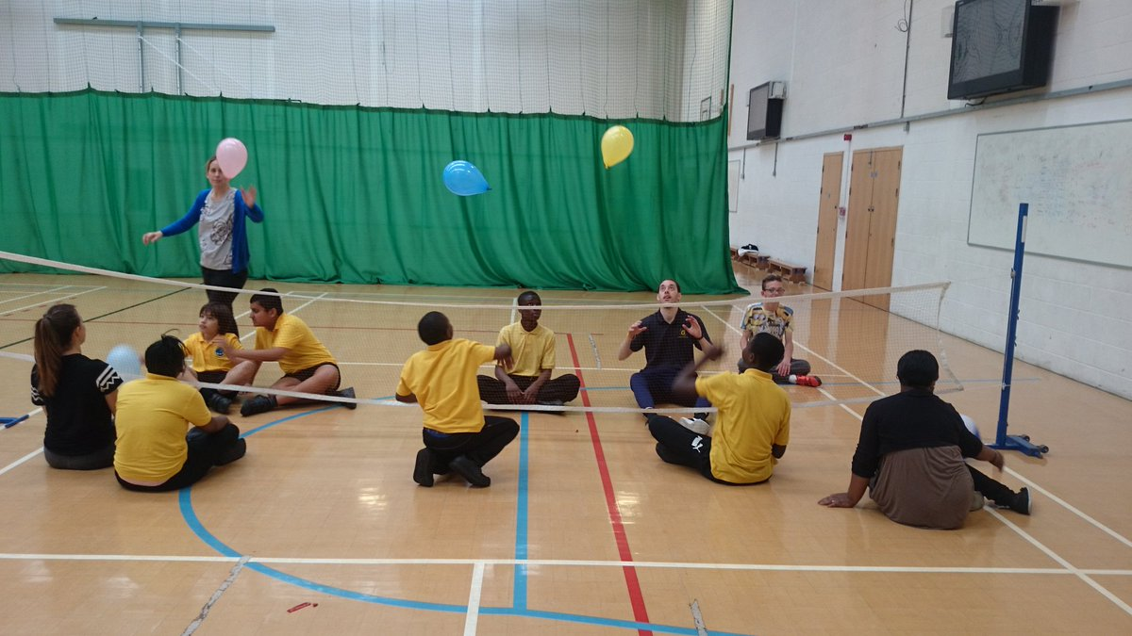
Inclusive Health Check
www.yourschoolgames.co.uk
Inclusive Health Check – A resource designed for schools to self-evaluate their provision of inclusive sport
20 Questions
Staff/Infrastructure
Inclusive PE Curriculum
Fully Inclusive OSHL Activites
Inclusive Level One competitions
Access to Inclusive Level 2 Competitions
Sustained participation in community
Produces an action plan with Actions/ Considerations & TOP TIPS to make your school PE & Sport more inclusive

Slide 25
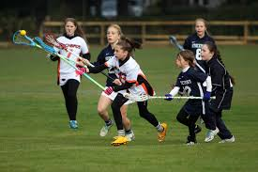
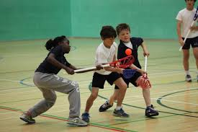
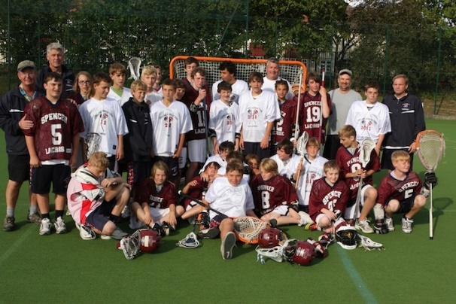
Hillcroft Lacrosse Club –
Lacrosse for schools in Wandsworth

Slide 26
Outline
What is Lacrosse?
Why Lacrosse?
Which versions exist?
Help we can offer
How to get involved?
Try Lacrosse at Merton Pop Lacrosse tournament

Slide 27
What is Lacrosse?
Lacrosse is a fast, high scoring team sport and typical invasion game
Different versions are available for different levels of ability
It is safe and easy to run as major and complimentary sport
Exit routes for all ages and sports to regional and national tournaments,
As a small sport, bespoke solutions achievable

Slide 28
Why Lacrosse?
‘level playing field’, no head start for stronger/faster/more experienced kids: the game requires a wide range of skills and abilities
Fun from the beginning: Easily accessible, many goals, ‘run and gun’ high scoring
Great addition to sports offered, engaging kids that might be unengaged in other sports
Kit provided and affordable at later stage

Slide 29
Which versions exist?
Pop Lacrosse:
No contact, no goalie, small goals, soft balls
Boys/men’s Lacrosse
Contact (no take outs for juniors), helmet, gloves, stick with pocket, 10 a side, white rubber ball
Goaltender, defender, midfield, attack
Girls/women’s Lacrosse
No contact but stick check in limits, mouthguard, stick without pocket, 12 a side, yellow rubber ball

Slide 30
Help we can offer
Hillcroft LC begin to establish a local network of youth and adult beginners’ and advanced Lacrosse
We can help with free taster sessions or local events
Dedicated six week programme available with external delivery
All coaches DSB checked and compliant with relevant regulation
We can deliver coaching qualifications

Slide 31
How to get involved?
Suggested route:
Tell us preferred date for pop lax tournament
Join Pop Lacrosse tournament
Determine what interest exists
Run dedicated lunch clubs, classes, etc
Review after three to six months and tailor offer to kids’ preferences and curriculum needs
If in doubt, ask and contact Hillcroft LC (hillcroftlax@gmail.com)

Slide 32
Try Pop Lacrosse at Merton Pop Lacrosse tournament
Scheduled for late October/early November, based on input from Wandsworth’s teachers
Format: Come to field, kids get brief 30min intro
Then the kids play a range of games
Winners can enter London Pop Lacrosse tournament
Cost to be determined but we expect this to be very affordable. We’re trying to get this funded.

Slide 33
Contact details
Henning Schmidt
Hillcroft Lacrosse Club
Club Development Officer
Hillcroftsummerlax@gmail.com
+44 7791 592 630
Rob Clark
Hillcroft Lacrosse Club
Community Coach
robclarktraining@gmail.com
+44 7770 411 628
& School Games Review
& School Games Review
Gabbi Simmonds
South East Regional Co-ordinator
English Lacrosse Association
+44 7751 747 027
g.simmonds@englishlacrosse.co.uk

Slide 34
Well Earned Break!

Slide 35
Schools Regular Running Programmes

Slide 36
Running Programmes Available
Daily Mile
Schools Run
Kids Marathon
Designed to keep it simple
In addition to PE lessons
Wandsworth Examples – different models

Slide 37
Enable Schools Running Fund
London Sport example
Funding via PH Wandsworth
Closing Date
Start Up Fund or a refresher fund
Start up grant for equipment
Grants of up to £200 can be applied for
Grants must be used to start or expand a regular running initiative aimed at 4 - 11-year-olds
Projects must be delivered outside of the PE curriculum
Grants can't be used to fund external coaches
Volunteering

Slide 38
Thanks for coming!

