Slide 1
Wandsworth Schools Primary PE Forum
Southfields Academy
15th June 2018

Slide 2
Welcome to Southfields Academy

Slide 3
Outline of the day
9:30pm – Welcome & Introductions
9.45am School Games Update
10.00am Competition review
10.30am – Sports Coaching / Regular Running – Natalie Pope
11am - Break- Tea & Coffee
World Cup Sweepstake draw
11.15am – School Games Mark 2018
12.00 noon – CPD 2018
Wandsworth District Football – Richard Siaw
12.30pm - Lunch Break
1.15pm – Active Planner workshop – 10 steps to an Active school
2.30pm - Depart

Slide 4
London School Games Finals 2018
Spring Finals 2018
Qualifiers for Summer Finals 2018
2nd Sheringdale - Quicksticks Hockey
3rd Sacred Heart - Hi5 Netball
4th Smallwood - Boccia
5th Ravenestone – Sportshall Athletics
5th Penwortham - Girls Football
10th Brandlehow - Tag Rugby
17th Penwortham - Best football
RFU Mega Fest – Heathmere
Belleville – Y5/6 Gymnastics
Belleville – Y3/4 Gymnastics
Furzedown – Best Cricket
Newton Prep –London Cricket
Thomas’s Clapham – Girls Cricket
Belleville –LYG Cricket
- Basketball
OLQH – Year 3/4 Mini Tennis
Allfarthing /Sacred Heart -Y5/6 Tennis

Slide 5
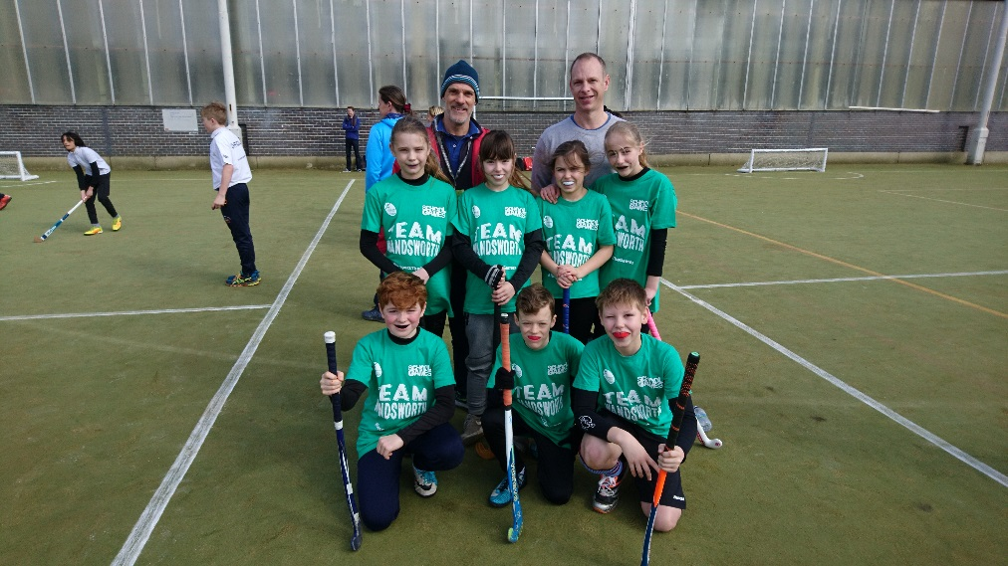
Wandsworth School Games Events
20th June – Quad Kids – SA
22nd June – Y5 Football -SA
25th June – Tri Golf – SA
26th June – Y5 Cricket – Spencer
29th June –Y5 Girls Football -SA
2nd July – Primary Panathlon -SA
5th July – London School Games Final
6th July – Y3/4 Cricket Festival – Spencer
10th July – Champions League football

Slide 6
School Games Changes for 2018-19
Wandsworth
Enable will no longer will be running School Games competitions:
Tag Rugby
Girls Football
Boys Football
Hi 5 Netball
Sportshall Athletics
London School Games
Year 6 Best Football removed
Replaced by Y3/4 Girls Football
Tri-Golf will become Y3/4 event
New Inclusive events:
Sitting Volleyball
New Age Kurling

Slide 7
Mission
Keeping competitive sport at the heart of schools and provide more young people with the opportunity to compete and achieve their personal best.
Vision
By 2020 the School Games will be continuing to make a clear and meaningful difference to the lives of even more children and young people.
Seeing changes in political landscape around PE & Sport including School Games focus away from competitive sport towards engaging more inactive children.
A
Notes:
Important at the start of the updates to re-iterate the Mission and Vision for the School Games of the back of the review.
Emphasise more Young People (Personal Best) not more events for same Young People
Meaningful difference – greater than participation (what difference is the calendar making, how many different Young People experience this difference....are they the young people that need it most?).

Slide 8
Principles of Competition New online tool fro schools on School Games dashboard
Young person’s motivation, competence and confidence are at the centre of the competition
The focus is on the learning and values development of young people rather than the result
Volunteers, leaders & officials trained appropriately & display positive behaviour
The environment is safe and appropriate
The facility & environment created reflects the motivations, competence & confidence of the young people and format of the competition
SMILES – check list
Safe
Maximum Participation
Inclusive
Learning
Enjoyment
Success
Promoting the School Games values to achieve the above

Slide 9
Good opportunity for reviewing competition programme
Group One:
Tag Rugby
Hi 5 Netball
Cricket
Group two
Gymnastics
Tennis
Athletics
Group Three
- Football
- CFC Boys & Girls Premier Stars
- AFC Wimbledon Kids Cup
- Trinity Cup
- Year 5 District
Festivals:
Mega Fest
Y2/3 Tennis Festival
Y3/4 Cricket Festival
Primary Panathlon
Tri Golf
Multi Skills
Multi Sports

Slide 10
School Games Mark 2018
Application window – Open until – Friday 3rd August 2018
Part of School Games programme
Recognised by Ofsted
Promotes sporting success
Links with Sports Premium fund
Recognition of schools hard work & commitment to PE & Sport
33 Wandsworth School successfully gained Award in 2017
6 Gold Awards, 17 Silver, 10 Bronze

Slide 11
SCHOOL GAMES MARK 2018 www.yourschoolgames.co.uk website:
In order to achieve School Games Mark of any colour schools must meet the following Pre-Requisites:
Register your School Games Day
Complete Inclusive Health Check
Register for the Active School Planner – Only 8 schools so far!
Set up School Games Crews
Have positioned a ‘personal challenge’ as part of School Games
Have a noticeboard & use social media to promote School Games activity.
.

Slide 12
Other Pre-requisites
A calendar of competition that demonstrates opportunities for young people with SEND
A notice board and/or in-house school digital system that promotes School Games activity.
System tracking young people’s participation in School Games.
Opportunities that attract less active young people to participate in physical Activity.
Have promoted and maximised School Values

Slide 13
Bronze award
Plans to provide 2 hrs of PE & sport a week
20% of students engaged in extracurricular every week.
Use School games formats to provide 5 x Level 1 competition opportunities – Intra school
Compete in 3 Level 2 competitions – Inter School
Engage 5% of students in leading, managing & officiating activity
No personal Challenge in place

Slide 14
Silver Award
10% students leading & officiating
Promote to parents - media
Students plan & development School Games
Utilise specialist coaches
Active links - 3 sports clubs
1 personal challenge
Completed - self review Activity Heat map www.activeschoolplanner.co.uk
Provide 2 hrs of PE & school sport per week
35% pupils in extra curricular activity a week
Targeted provision of 10% of least active children
6 x Intra School Competitions
4 x Inter school competitions
2 x B Teams

Slide 15
Congratulations Riversdale – Silver Award

Slide 17
Gold Award
2 hrs PE in curriculum p/wk
50% pupils -extra curricular
8 x Intra School Comps
6 x Inter school comps
3 B Teams, 1 C Team
Promote to parents to every 2 weeks
15% leading & officiating
School Games Crew in place
Targeted provision of 15% of least active children
2 personal challenges
Utilise specialist coaches
Active links - 5 sports clubs
CPD staff to support school sport
Provide support for gifted & talented
All pupils take on leadership roles in PE Lessons
Completed - self review Activity Heat map www.activeschoolplanner.co.uk

Slide 18
Platinum Level
Must have held the Gold Award in:
2014/2015/2016/2017
….and achieve GOLD in 2018
This will be through a case study report including:
Involvement of pupils - comps
Supporting pupils – Exit routes
60 minutes of activity a day
Supporting paragraph from SGO
Apply for Gold as usual,
If successful need to provide Platinum evidence above.
Provide support for gifted & talented
Platinum Award last for 2 years

Slide 19
WORLD CLASS TIPS FOR SGM 2018
Read criteria carefully!
School Games Mark Criteria 2018 available on webpage
Supporting information for school
Collate evidence in a folder
Promote activities on Twitter
Come along to SGM workshops/clinics at Southfields, 3.30-5.30pm
Wednesday 11th July
Tuesday 17th July
Keep in touch up until 20th July 2018
Follow on Twitter @wandschoolgames

Slide 20
Richard Siaw Wandsworth District Football

Slide 21
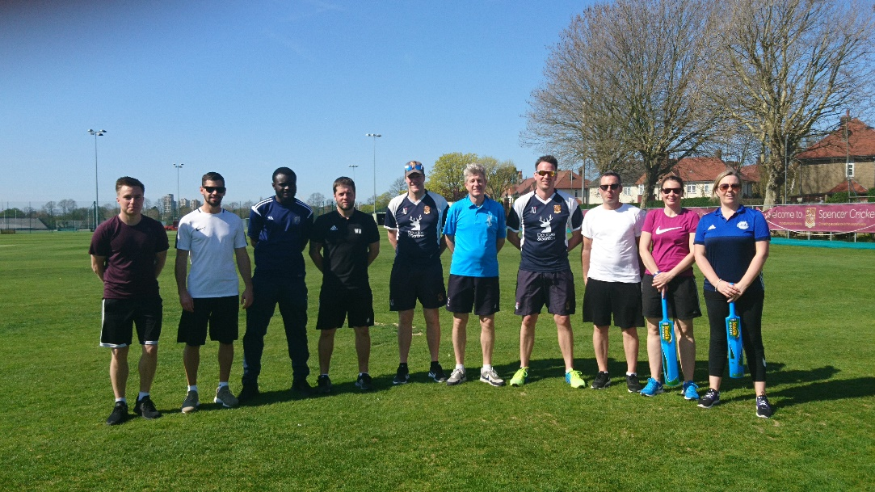
Wandsworth CPD programme
3 x Primary PE Forums
Programme of Sports Specific Courses:
Quick Sticks
Inclusive PE Course
FA Primary Teachers Award
Primary Cricket with Surrey Cricket
Primary Tennis with LTA
Girls Active Training day
Playground Leaders Courses;
St Mary’s Battersea. OLQH, West Hill, John Burns, Holy Ghost, Penwortham, Fircroft. Granard
Lunchtime Supervisors Courses for schools

Slide 22
What CPD would you like in 2019?

Slide 23
Thanks For coming

