Slide 1
Wandsworth School Games
Primary School PE Forum
12th July 2019
Southfields Academy

Slide 2
What’s Going On?
9:30am – Welcome & Introductions
9.40am – Head, Hands, Heart Icebreaker
9.50am – Wandsworth School Games updates
Feedback session
10.15am – Enable –Natalie Pope
11am – BREAK
11.15am – Shopping List Game
11.20am SGM Update
11.35 am – Summer Events
11.50pm –12.10pm – Feedback -
12.30pm - Depart

Slide 3
Developing well balanced young people through Physical Education
Head (thinking)
Hands (doing)
Heart (Behavioural Change)

Slide 4
HEAD, HANDS, HEART Ice, Ice baby Icebreaker
HEAD -
THE THINKING PHYSICAL BEING:
Decision making
Analytical-deep understanding
Confident
Creative
HEART -
THE BEHAVIOURAL CHANGE PHYSICAL BEING:
Involved and engaged
Grows socially and emotionally
Builds character and values
Leads a healthy active lifestyle
HANDS _
THE DOING PHYSICAL BEING:
Physically competent
Grows and develops
Physically active
Competitive
TASK:
Using the appropriate thought bubbles please write down three activities/actions/events that have gone well in your PE & sport provision this year.

Slide 5
School Games in the Spring Term
Spring Term Competitions:
Sportshall Athletics
Hi 5 Netball – 28th Jan & 5th Feb
Sitting Volleyball – 12th Feb
Quicksticks Hockey – 15th Feb
Mega Fest Rugby – 1st March
Y3/4 KS Gymnastics – 1st April
Y5/6 KS Gymnastics – 3rd April

Slide 6
Discussion – new formats of spring competitions
Key Steps Gymnastics
Spread over 2 dates again
Judging course in 2020
Body Management added?
Advanced event?
Sportshall Athletics
Split into morning and afternoon sessions
2 venues
External organisation

Slide 7
London School Games – Spring Finals Wandsworth Teams
2nd Ravenstone – Sportshall Athletics
3rd Honeywell - Quicksticks Hockey
8th The Roche - Hi5 Netball
13th Sacred Heart – Boccia
13th Swaffield – Sitting Volleyball
14th Sheringdale - Tag Rugby
25th Shaftesbury Park - Girls Football
RFU Mega Fest – St Anne’s

Slide 8
Summer Events
Pathway events
Festivals
Tri Golf -15th May
Boys Cricket – 21st May
Mini Tennis Orange – 22nd May
Mini Tennis Red – 6th June
3v3 Basketball –May/June
Girls Cricket – 11th June
Quadkids Athletics - 13th June
Y5 Cricket – 27th June
Year 2/3 – Tooting Bec – 10th May
Year 2/3 – King George’s – 11th May
Year 3/4 Girls Football Festival -18th June
Year 5 Boys Football – 24th June
Year 5 Girls Football – 1st July
Cricket Festival – Year 3&4 – 5th July

Slide 9
London School Games – Summer Finals Wandsworth Teams
2nd Thomas’s Clapham – Girls Cricket
3rd Prospect House – Best Cricket
5th Ravenstone – Quad kids Athletics
6th Riversdale - KS2 Gymnastics
8th Riversdale - Basketball
11th Swaffield – Y5/6 Tennis
13th Belleville - Y3/4 Tennis
20th Honeywell – KS3 Gymnastics
Girls Football Festival – Granard

Slide 10
SCHOOL GAMES MARK 2019 – The story so far………
4 Gold:
John Burns
Riversdale
Swaffield
Honeywell
Silver:
Allfarthing
Granard
Sacred Heart Roehampton
Trinity St Mary’s
Bronze:
Our Lady of Victories
St Michael’s

Slide 11
SCHOOL GAMES MARK 2019 www.yourschoolgames.co.uk website:
In order to achieve School Games Mark of any colour schools must meet the following Pre-Requisites:
Register your School Games Day
Complete Inclusive Health Check
Register for the Active School Planner
Set up School Games Crews
Have positioned a ‘personal challenge’ as part of School Games
Have a noticeboard & use social media to promote School Games activity.

Slide 12
TOP TIPS for the SGM Application
Read criteria carefully!
School Games Mark Criteria 2019
Application window – Open until – Friday 2nd August 2019
Come along to SGM workshops/clinics at Southfields,
This afternoon – 1.30-3pm
Wednesday 17th July, 3.30-5.30pm
Keep in touch up until 1st August

Slide 13
Courses for Teachers
Courses held for teachers:
3 x PE Forums
Sportshall Athletics
Quicksticks Hockey
FA Teachers Course
Primary Dance
FA Active Play Through Storytelling
Maths of the Day
Primary Cricket

Slide 14
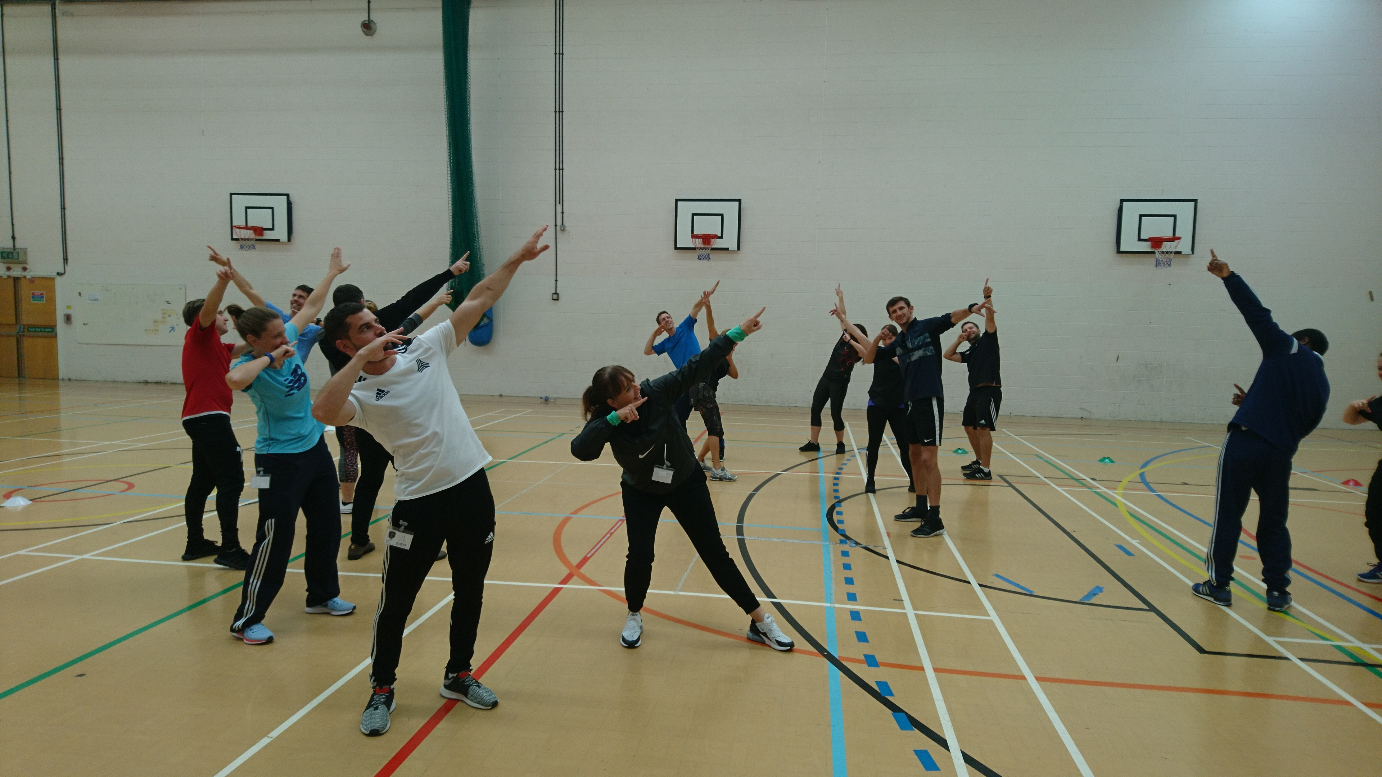
CPD Courses 2020
Maths of the Day Course
14th November 2019
Active English Course-
30th September 2019
Primary PE Forum
13th September 2019

Slide 15
Badminton Racket Pack Programme
Free Racket Pack Workshop
Southfields Friday 13th Sept 2019
Free access to Badminton England’s online lesson plans, resources, games ideas, video.
Racket Pack as part of their 2019/20 PE curriculum
Wandsworth Racket Pack Festival w/c 25th November 2019
London School Games Finals

Slide 16
What is The Racket Pack?
Badminton England's latest programme aimed at 5 – 11 year olds.
Designed to provide fun sessions that teach children the essential skills of badminton.
The content is suitable for both teachers and coaches to deliver both within curriculum and out of.

Slide 17
How does The Racket Pack work?
The programme content is broken down into 3 age groups:
Key Stage 1: Yr 1 & 2 (Age 5-7)
Key Stage 2: Yr 3 & 4 (Age 7-9)
Key Stage 2: Yr 5 & 6 (Age 9-11)
For each age group we provide:
6 sessions for initial delivery (Module 1)
6 sessions for extension (Module 2)
The content covers the following 5 key skills:
Grips, Movement, Forehand & Backhand Serving, Underarm hitting and Overhead hitting

Slide 18
How is The Racket Pack delivered?
Schools will be able to choose how they wish to deliver The Racket Pack
The options are:
Coach delivery: An approved Racket Pack qualified coach will come in and deliver all sessions.
Teacher delivery: An identified teacher will attend a practical CPD workshop that will provide all the technical knowledge required to deliver the programme.
Coach Mentor and Teacher delivery: Identified teacher will work alongside a coach to gain badminton knowledge.

Slide 19
Is there a resource for The Racket Pack?
The programme resource will be provided through an Online Resource platform that gives teachers with access to:
Lesson Plans
Technical videos
Ability to build your own sessions by choosing between the various warm ups, skills and games.

Slide 20
Is there a competition format?
Yes!
There is a new competition format:
- ‘Smash’ festival format for Key Stage 1,
- ‘Tink’ and ‘Flo’ tournament format for Key Stage 2
There are also festival formats at the end of each module per age group that will allow for inter and intra competition.

Slide 21
Wandsworth Racket Pack Programme 2019/20
Wandsworth Racket Pack CPD Workshop
Friday 13th September
Racket Pack Delivery
Primary schools deliver Racket Pack as part of PE curriculum
Wandsworth Racket Pack Festival
Date: W/c 25th November 2019
London Youth Games Spring Finals
Winning schools represents Wandsworth at the London Youth Games Racket Pack Spring Finals
March 2020

Slide 22
Spencer Lynx Hockey
New Community Outreach hockey Programme
Offering free & subsidised hockey sessions to local state schools
Focus on Year 5’
Curriculum, after–school clubs,
Visited Trinity, Broadwater, Hillbrook, Smallwood & Gatton
Booked into Alderbrook, Earlsfield, Sellincourt
Free Sunday coaching sessions at La Retraite School, Balham
Seen over 250 children, made over 150 offers of places, with 35 acceptances
Rhys Smith, GB international has just become the Lynx ambassador an will lead some of the coaching sessions
Contact: Charlotte Hucker
spencerlynxhockey@gmail.com
charlottehucker@yahoo.co.uk

Slide 23
Here comes the summer! Have a great holiday!

