Slide 2
What is The Racket Pack?
Badminton England's latest programme aimed at 5 – 11 year olds.
Designed to provide fun sessions that teach children the essential skills of badminton.
The content is suitable for both teachers and coaches to deliver both within curriculum and out of.

Slide 3
How does The Racket Pack work?
The programme content is broken down into 3 age groups:
Key Stage 1: Yr 1 & 2 (Age 5-7)
Key Stage 2: Yr 3 & 4 (Age 7-9)
Key Stage 2: Yr 5 & 6 (Age 9-11)
For each age group we provide:
6 sessions for initial delivery (Module 1)
6 sessions for extension (Module 2)
The content covers the following 5 key skills:
Grips, Movement, Forehand & Backhand Serving, Underarm hitting and Overhead hitting

Slide 4
How is The Racket Pack delivered?
Schools will be able to choose how they wish to deliver The Racket Pack
The options are:
Coach delivery: An approved Racket Pack qualified coach will come in and deliver all sessions.
Teacher delivery: An identified teacher will attend a practical CPD workshop that will provide all the technical knowledge required to deliver the programme.
Coach Mentor and Teacher delivery: Identified teacher will work alongside a coach to gain badminton knowledge.

Slide 5
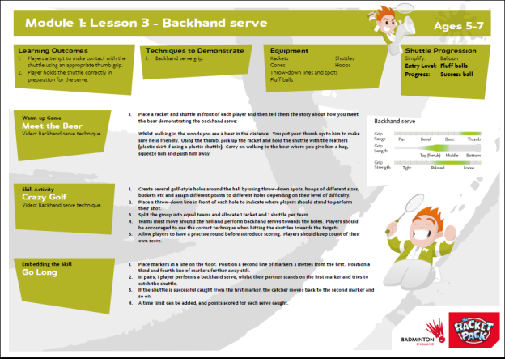
Is there a resource for The Racket Pack?
The programme resource will be provided through an Online Resource platform that gives teachers with access to:
Lesson Plans
Technical videos
Ability to build your own sessions by choosing between the various warm ups, skills and games.

Slide 6
Is there a competition format?
Yes!
There is a new competition format:
- ‘Smash’ festival format for Key Stage 1,
- ‘Tink’ and ‘Flo’ tournament format for Key Stage 2
There are also festival formats at the end of each module per age group that will allow for inter and intra competition.

Slide 7
Wandsworth Racket Pack Programme 2019/20
Wandsworth Racket Pack CPD Workshop
Friday 13th September
Racket Pack Delivery
Primary schools deliver Racket Pack as part of PE curriculum
Wandsworth Racket Pack Festival
Date TBC
London Youth Games Spring Finals
Winning schools represents Wandsworth at the London Youth Games Racket Pack Spring Finals
March 2020

